Slide 1

EMPLOYEE ATTRITION CASE

Slide 2

HELLO!
I am Abiola Adeyinka Mariam
I am here because of the internship opportunity from Hash Analytics

Slide 3
ATTRITION
Reduction of strength or effectiveness

Slide 4

Employee Atrrition is the gradual reduction of a workforce by employees through resignation and retirement
This Photo by Unknown Author is licensed under CC BY-NC-ND

Slide 5
Introduction
I used Company X employee attrition dataset for this analysis.
The dataset includes features like satisfaction level, number of project, work evaluation etc.
Objective: what types of employee are leaving and employees prone to leave.

Slide 6
PROCESS
Data Preparation
Data Analysis
Model and Evaluation
Importing required libraries , loading the dataset and formating.
Perporming explorative analysis and visualizations to gain insights on the features and relationship with the target class.
Training the dataset on machine learning algorithm to predict the attrition and evaluate the model accuracy.
1
2
3

Slide 7
Data Preparation
Import libraries
Load and Format Dataset
Load the excel datasets into pandas
Add the attrition column and
Merge the two datasets into 1 by the rows.
Libraries
Import pandas as pd
Import numpy as np
Import SciPy as sp
Import seaborn as sns
Import matplotlib.pyplot as plt

Slide 8
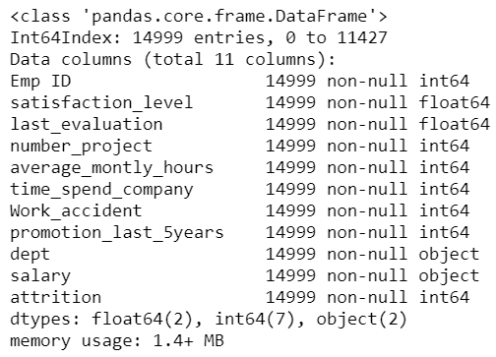
Data Analysis
Explorative Analysis
Understanding the data by looking at the data types of features, shape of dataset, distribution of the numerical and categorical data set.
Also, looking at the relationship between the features and the target class.
Then, transforming the categorical features to numeric values.

Slide 9
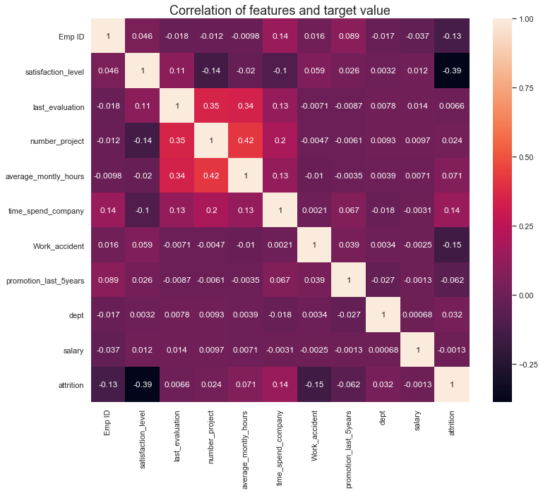
Explorative Analysis
There is a high negative correlation between satisfaction level and the attrition .
I assume that employees with a lower satisfaction level leave the company more.
Why do they have lower satisfaction level?
There is also a high correlation between number of projects, average monthly hours and last evaluation.
Lets dig further.
9

Slide 10

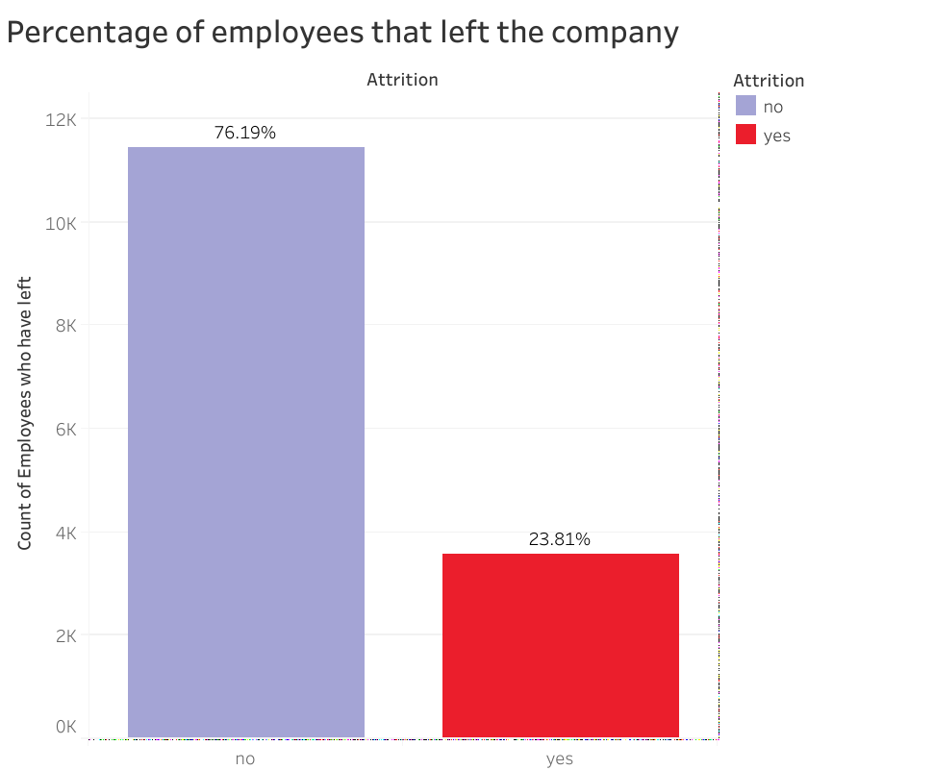
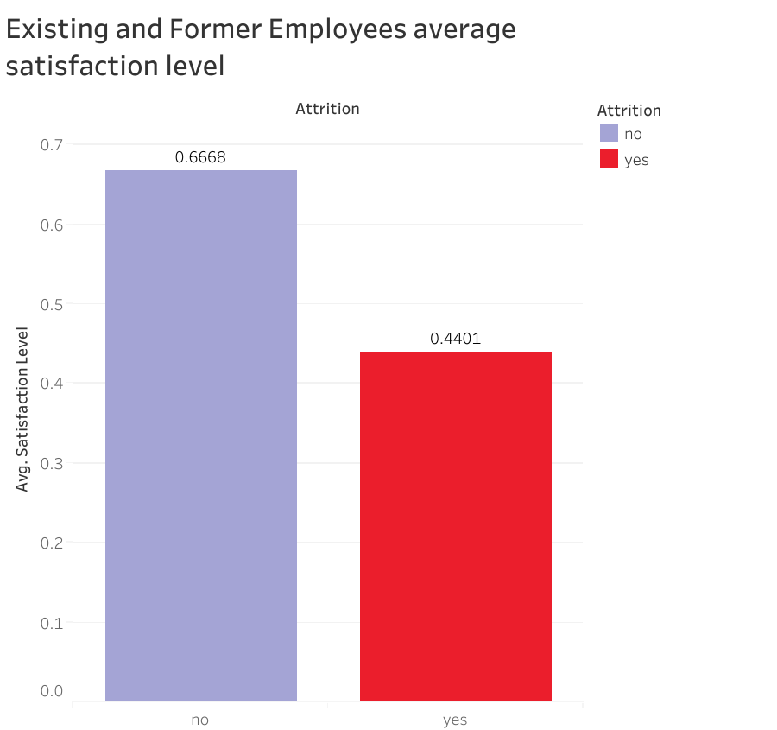
VISUALIZATION

Slide 11
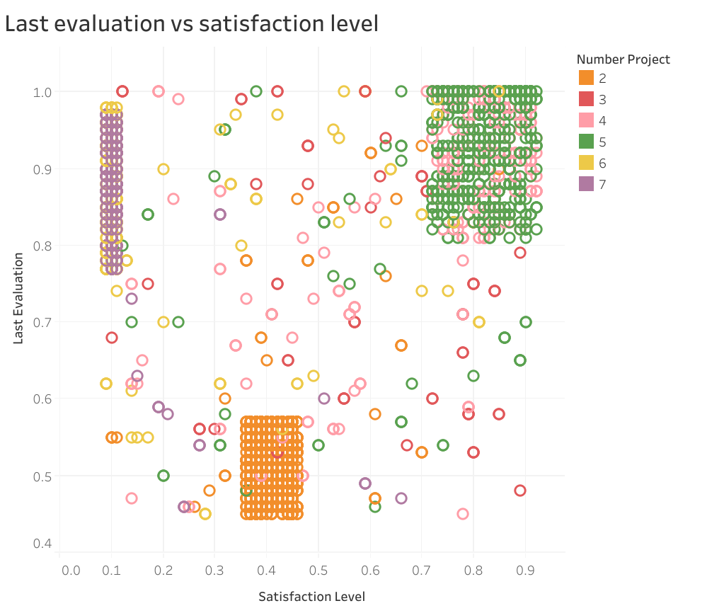
Types of Employees that left
3 observations
Unsatisfied and overworked employees
Unsatisfied and underworked employees
Ideal and satisfied employees

Slide 12
Modelling and Evaluation
Predicting the attrition
We will train the dataset using 6 common classification algorithms and find the best algorithm with the accuracy for the problem.
The algorithms used are
Logistic Regression
Naïve Bayes
K-Nearest Neighbours
Decision Tree
Random Forest
Support Vector machine.
Steps To build classification Model
Divide the dataset into X and Y variables
Split the dataset into train and test set.
Import the classifier to be used from sklearn
Initialize the classifier
Train the classifer by fitting the model
Predict the target
Evaluate the model for accuracy
Evaluation and Prediction of new employees prone to leave
Random forest algorithm gave the best accuracy score of 0.99 than other algorithms. Therefore, Random forest model is the best fit for this problem.
We predicted that employees with id numbers 9914, 3596, 7078, 7005, 6743 and 14192 are prone to leave in future.

Slide 13
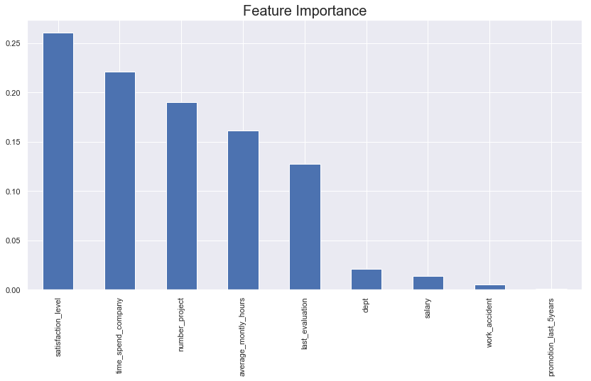
Random forest model provides the importance of features in the model. The feautures that contribute most to the attrition.
Looks like satisfaction level contributes most to Attrition of employees

Slide 14

Conclusion
Employee Attrition
From the data, we saw the types of employees that left and why they left but I believe that the correlation alone is inadequate to improve satisfaction level.
We saw that random forest is the best fit over other classification algorithms. And the factors which are most important in order to avoid attrition of employees.
Lastly, we predicted the employees that are prone to leave if improvements are not made.

Slide 15
THANKS!
For the opportunity
Hash Analytics

